Slide 1

Stage 2 Indoor Vibes Course Designer: Marcel Englmaier
Indoor Vibes is a 21 round, 105 point Comstock Medium course. There are 7 USPSA targets. The best 3 hits per target will score. The start signal is audible.
The Handgun start position is standing anywhere inside the shooting areas with wrists below belt. Handgun loaded and holstered. The PCC start position is standing anywhere inside the shooting areas with PCC loaded, stock on belt, safety on.
On the audible start signal, engage all targets from within the shooting areas.

Slide 2
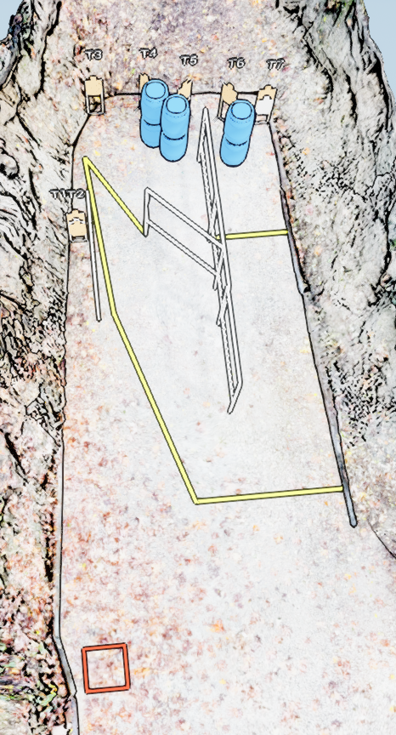
 | Stage 2 Indoor Vibes Course Designer: Marcel Englmaier

